Slide 1
Data Center Infrastructure CT109-3-2&Version 2
IT Hardware

Slide 2
Topic & Structure of The Discussion
Understand IT Hardware

Slide 3
Learning Outcomes
At the end of this topic, YOU should be able to:
Understand IT Hardware

Slide 4
Key Terms You Must Be Able To Use
If you have mastered this topic, you should be able to use the following terms correctly in your assignments and exams:
Rack
Blade
Tower
DAS
NAS
SAN

Slide 5
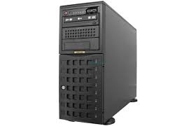
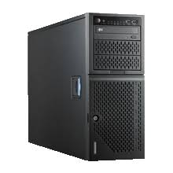
Servers: Tower Server
A tower server is a computer intended for use as a server and built in an upright cabinet that stands alone.
The cabinet, called a tower, is similar in size and shape to the cabinet for a tower-style personal computer.
This is in contrast to rack server s or blade server s, which are designed to be rack-mounted .

Slide 6
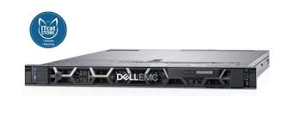
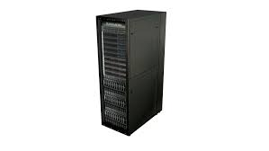
Servers: Rack Server
As the name implies, rack servers are servers that are mounted within a rack.
The rack is of a uniform width and servers are mounted to the rack using screws.
Each rack can accommodate multiple servers and the servers are typically stacked on top of each other.
Rack server is a server that is placed in a standard 42u rack unit, with a typical server starting at 1u and going up.

Slide 7
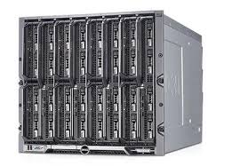
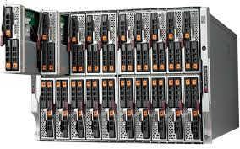
Servers: Blade Server
In general, a blade server consists of a chassis, or box-like structure, housing multiple thin, modular electronic circuit boards, known as server blades.
They are called blades because of their ultra-thin shape. Each blade contains a single server, often dedicated to a single application.
The individual blades contain processors, memory, integrated network controllers, an optional Fibre Channel host bus adaptor (HBA) and other input/output (IO) ports. These are used to connect server blades to other server blade units within the system, or to connect individual blades to power sources.

Slide 8
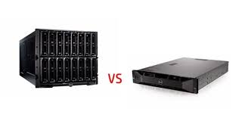
Blade Server Vs Rack Server
Let us compare blade server and rack server advantages.
1.Are they saving space?
The blade Server saves more space than the rack server.
2.Are they easy to deploy cables or manage?
The blade servers are easier to manage, providing more processing power in smaller spaces, and less cost. As the blade server units are hot-swappable, they are easy to troubleshooting. The rack servers are standalone devices so that it’s more difficult to troubleshooting.

Slide 9

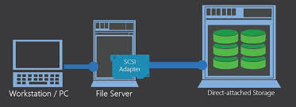
Storage: DAS(Direct Attached Storage)
Direct attached storage (DAS), also called direct attach storage, is digital storage that is attached directly to a computer or a server.

Slide 10
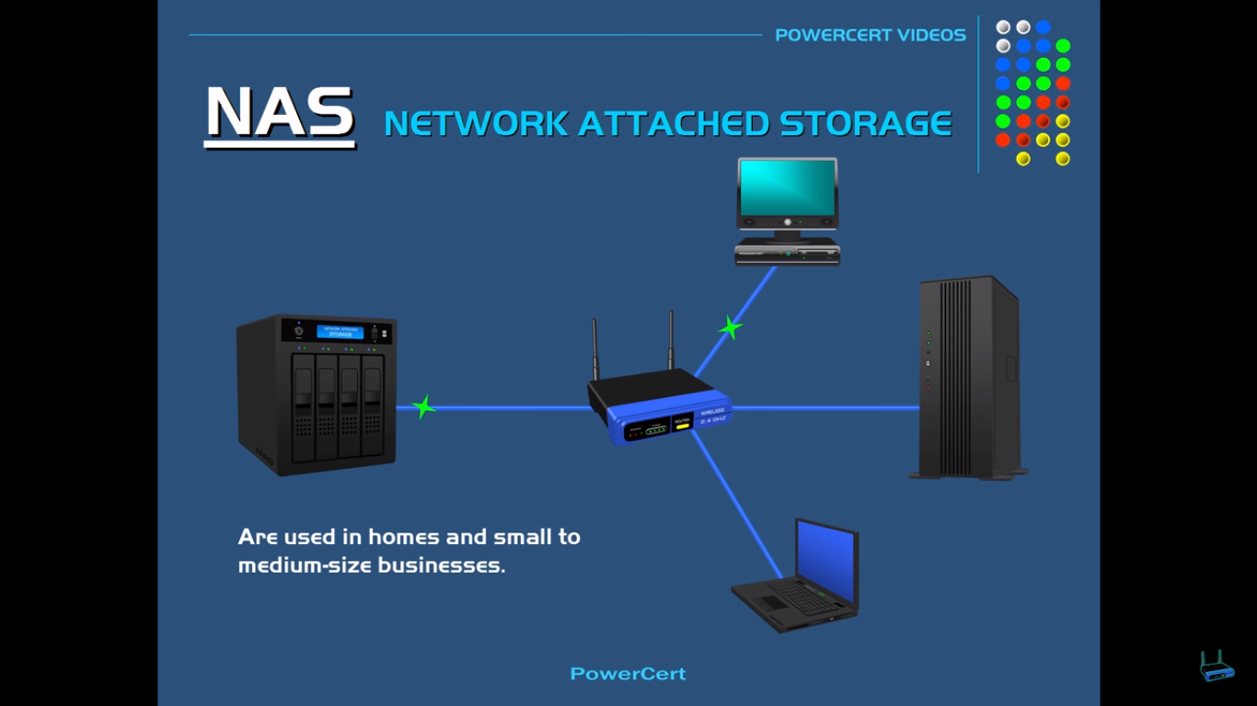
Storage: NAS(Network Attached Storage)
A term used to refer to storage devices that connect to a network and provide file access services to computer systems.

Slide 11
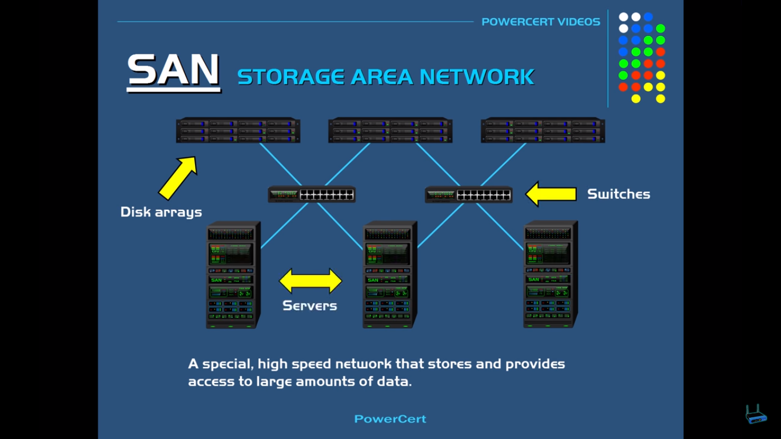
A storage area network (SAN) is a dedicated high-speed network or subnetwork that interconnects and presents shared pools of storage devices to multiple servers.
Storage: SAN(Storage Area Network)

Slide 12
Quick Review Questions
Discuss three types of servers
Discuss three storage types
Class Exercise Uploaded in Teams
- Tutorial IT Hardware

Slide 13
Summary of Main Teaching Points
Discussed IT Hardware

Slide 14
Question and Answer Session
Q & A

Slide 15
What we will cover next
BMS & EMS

